Slide 1
MI Collimation
2007 Shutdown
Bruce C. Brown
Proton Plan PMG
28 September 2006

Slide 2
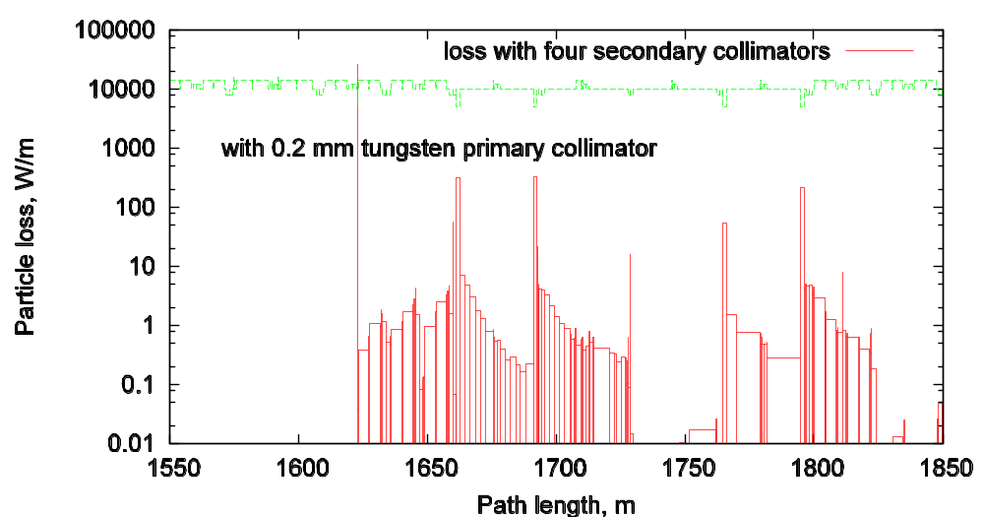
MI Collimation
Horizontal/Momentum Collimation (default plan)
Primary Collimator at MI230 – 15 mil W with motion system
Secondary Collimators near Q301, Q303, Q307, Q309
Simulation for Slip-stacking Loss

Slide 3
MI Collimation
Mechanical System Implementation
Test Primary Collimator being readied for installation at MI230 – evaluate for use a final device (secondary for test is temporary).
20 Ton Secondary Collimator Design work proceeding for Q303 region – need to resolve issues soon to permit ordering long lead items in two weeks (??)
Radiation Calculations required for both primary collimator test and to check concept.
Water pipes limit vertical height of collimator -- need to evaluate impact.

Slide 4
MI Collimation
Schedule
Location for Primary and at least on secondary established on Sept 5
All Horizontal Locations to be set by mid-October
Begin procurement in December, fabrication in January.
Install during Summer 2007 Shutdown.

Slide 5
MI Collimation
Issues :
Vertical collimation? Currently simulating slipstacking losses only.
Conclude that ECOOL region is protected but this critical issue needs attention.
Still need lots of attention to
  Radiation Calculations
  Big picture issues for mechanical design

